Slide 1
Secured Smart House Prototyping
Serik Zhilibayev
Aibek Ziyashev
Altyn Zhelambayeva
Advisor:
Prof. Adnan Yazici

Slide 2
Problem Definition
Proposed Solution
Smart home automation and security system
Communication between the system and the user
Anti-burglary system
Safe environmental sensing and real-time monitoring [1, 2]
Automatic notification system through Telegram bot [3, 4]
Face detection and person identification

Slide 3
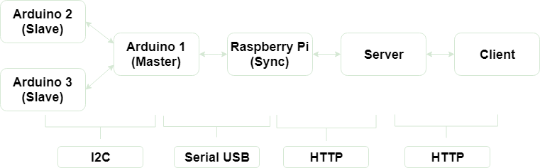
Overall architecture
Radio

Slide 4
Arduino Wireless Connection
Arduino 1
(Master)
{room_id: 2; led: 1; motor: 0}
{room_id: 3; led: 0; motor: 1}
{room_id: 2; light: 155; pir: 247; gas: 128}
{room_id: 3; light: 349; pir: 172; humidity: 293}
Arduino 2
(Slave)
Arduino 3
(Slave)

Slide 5
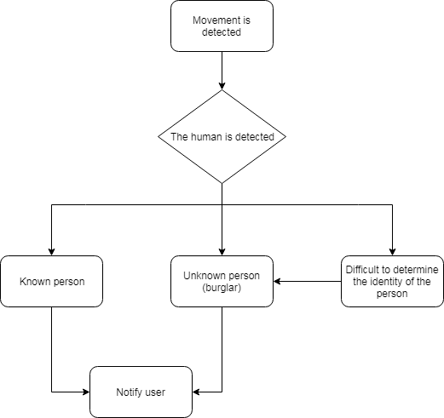
Intruder detection system
Rpi Streams Video
Remote Server processes the stream
Server identifies the person
Web application shows the result

Slide 6
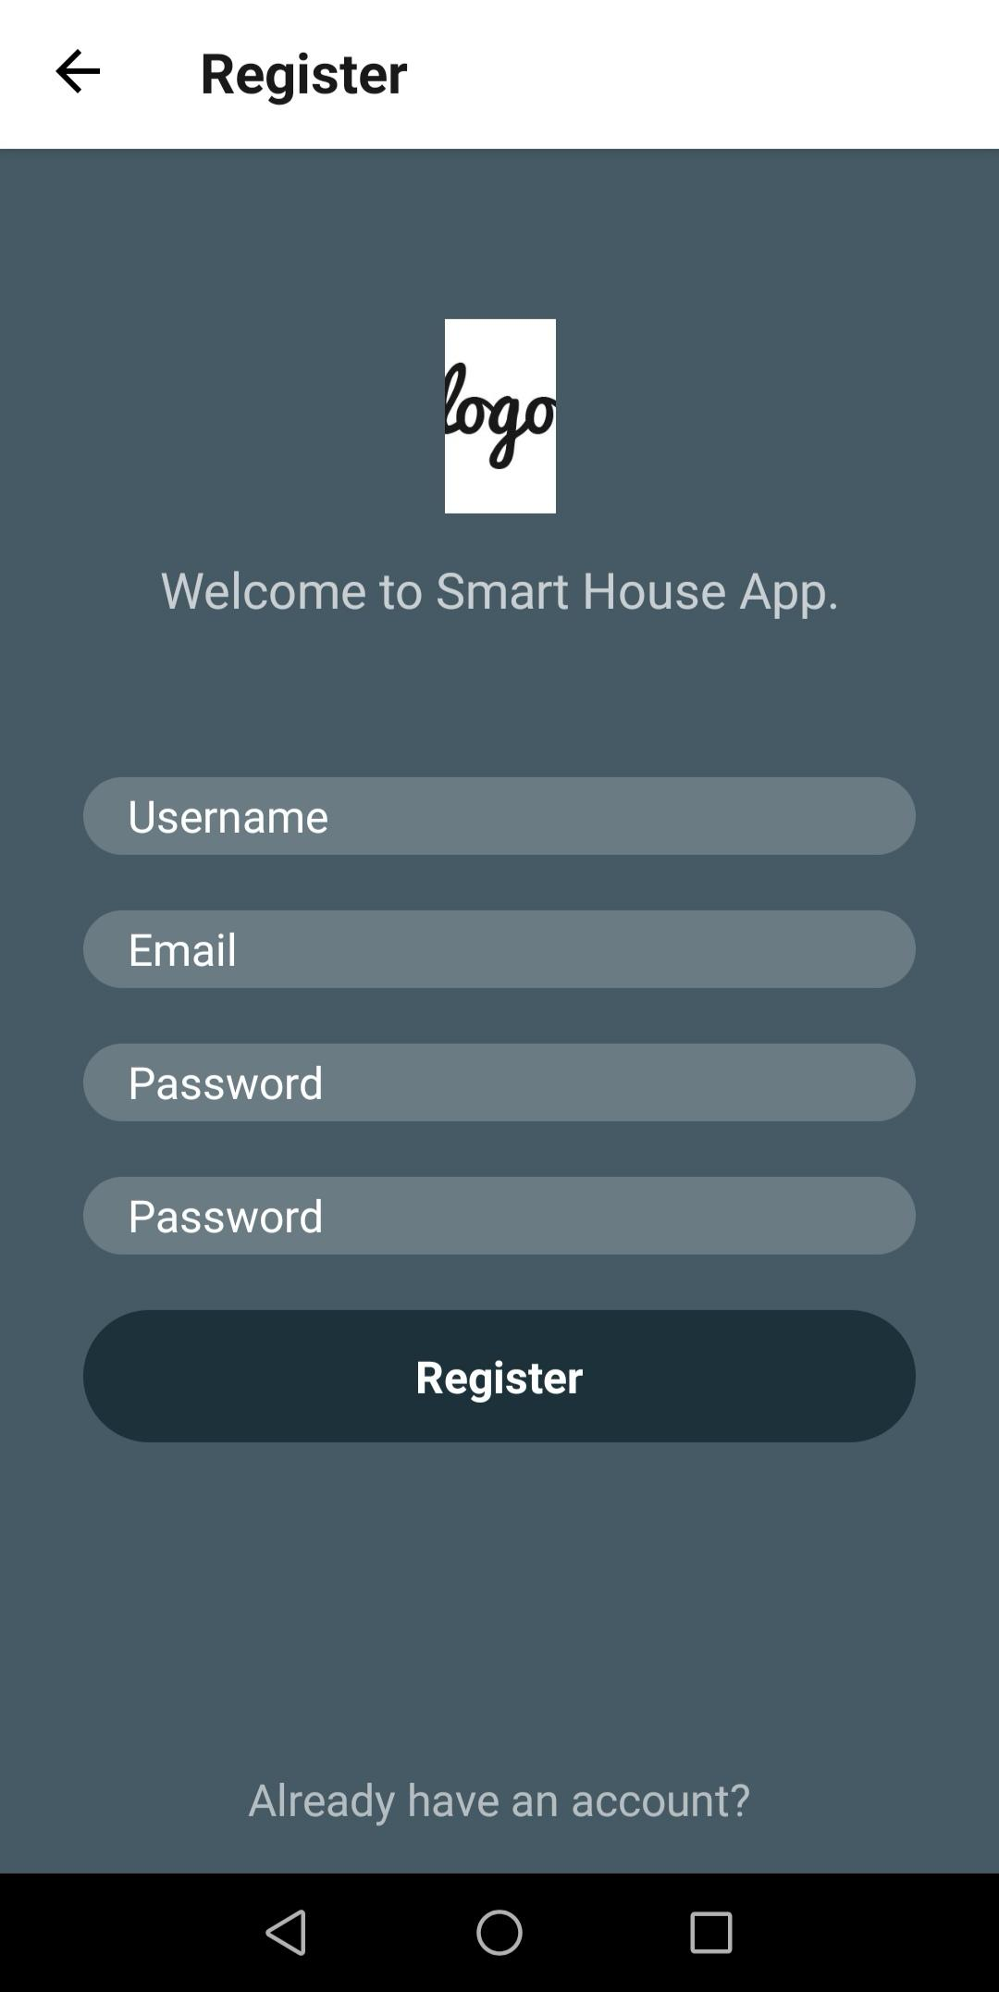
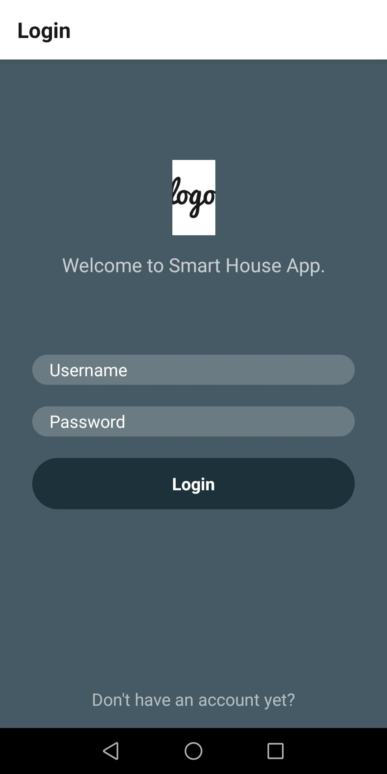
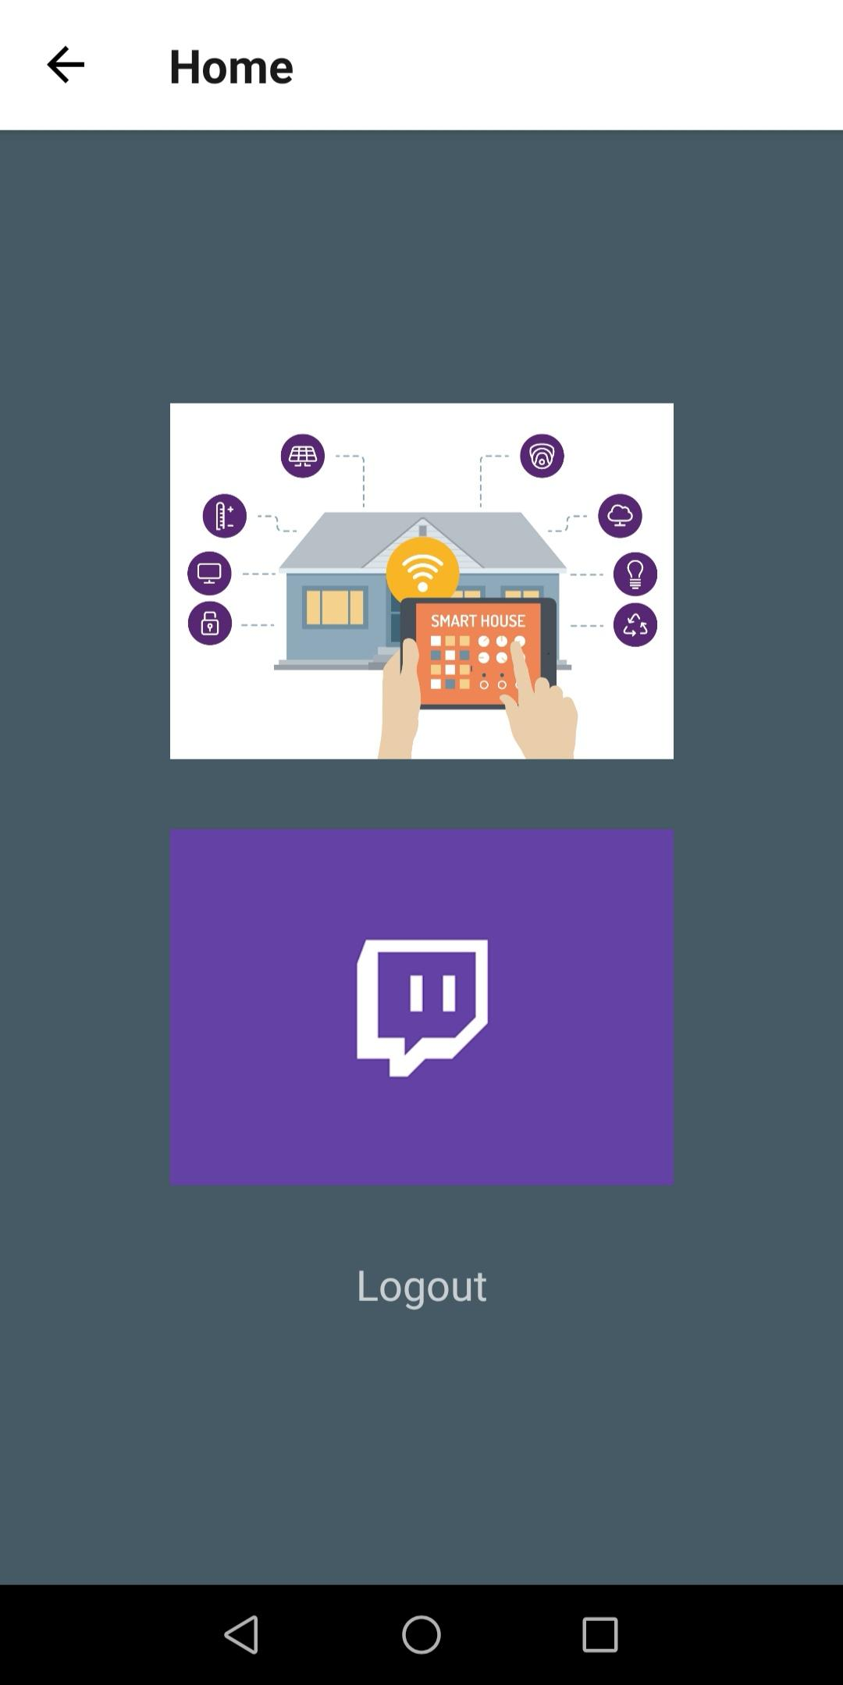
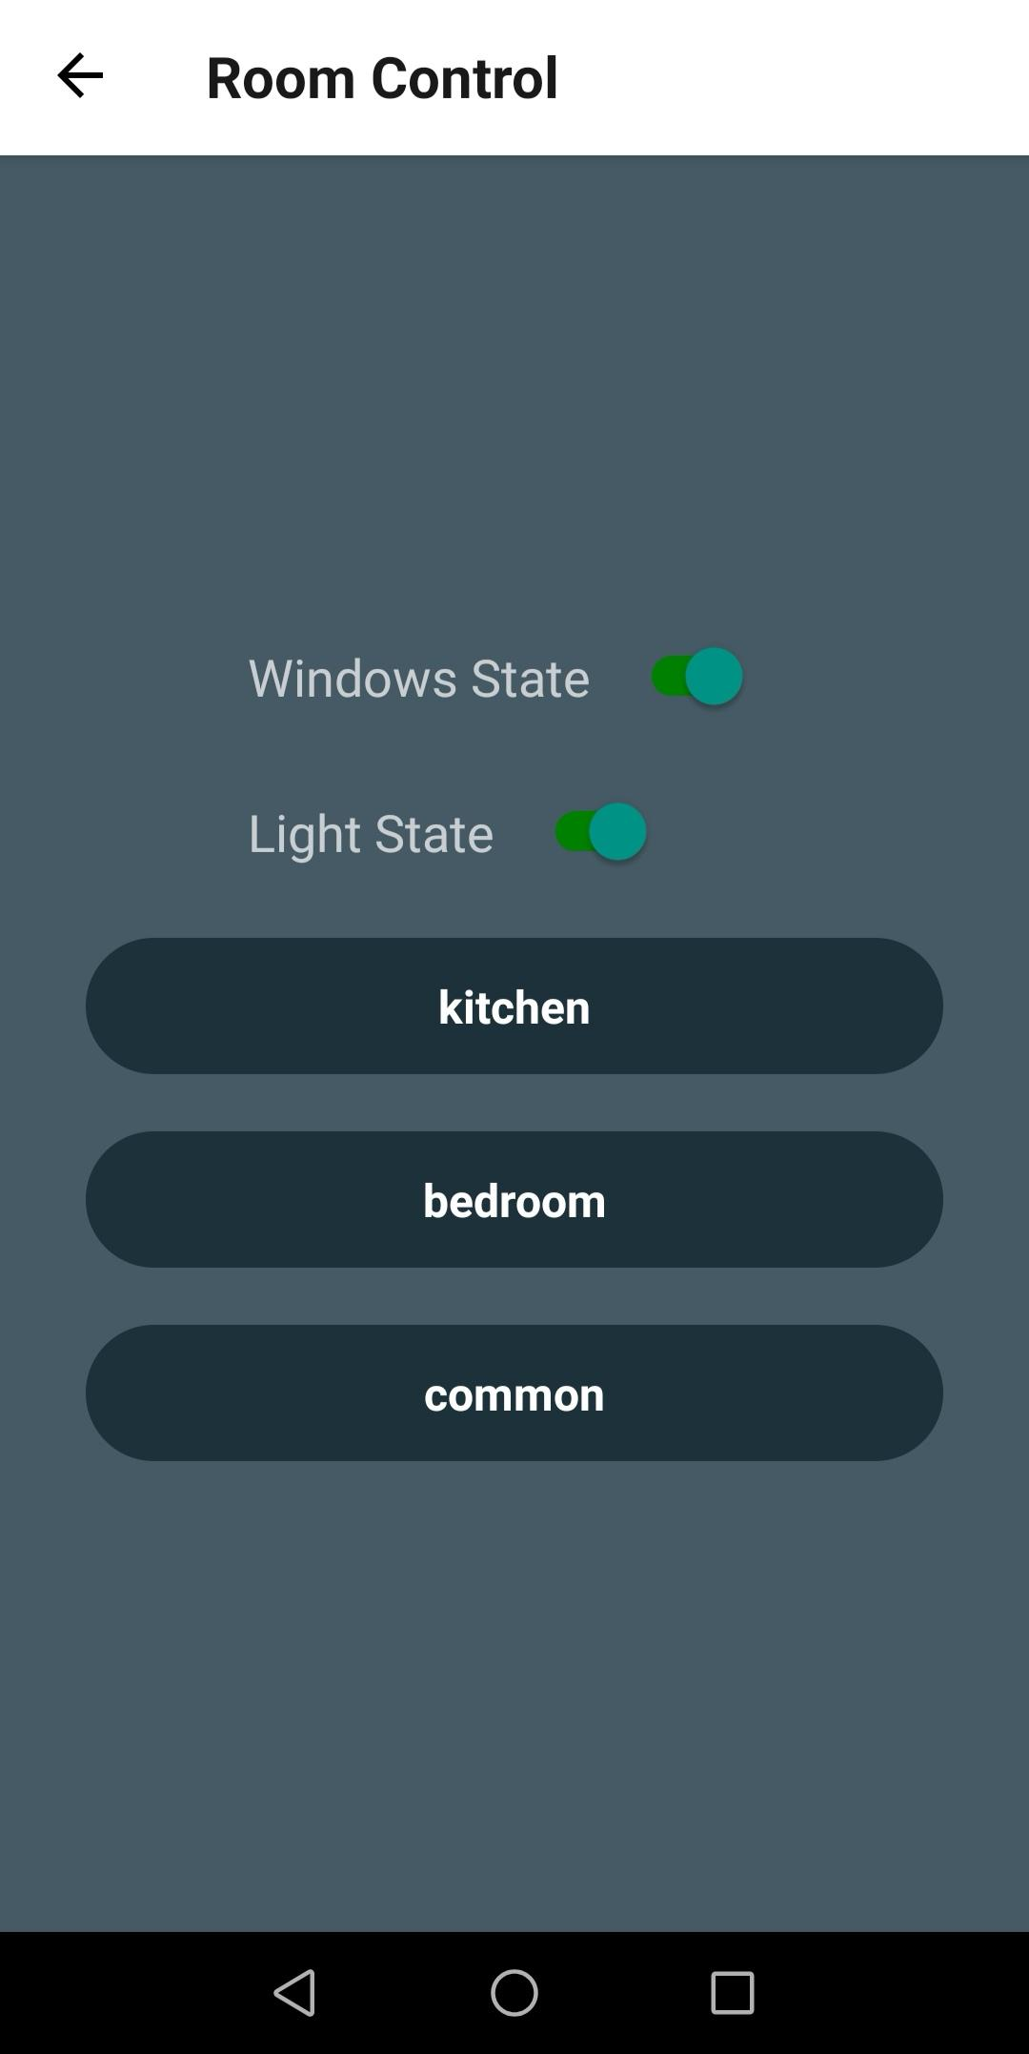
Basic functionality of Mobile Application
Register
Login
Main menu
Actuator control

Slide 7
Link
https://youtu.be/wLaPBXXaMHg

Slide 8
Thank you for your attention!

Slide 9
References
[1] N. David, A. Chima, A. Ugochukwu and E. Obinna, 2018. [Online]. Available: https://www.researchgate.net/publication/279179486_Design_of_a_Home_Automation_System_Using_Arduino. [Accessed: 23- Sep- 2018].
[2] R. Kodali, V. Jain, S. Bose and L. Boppana, "IoT based smart security and home automation system", 2016 International Conference on Computing, Communication and Automation (ICCCA), 2016
[3] M. Asadullah and A. Raza, "An overview of home automation systems", 2016 2nd International Conference on Robotics and Artificial Intelligence (ICRAI), 2016.
[4] M. ShariqSuhail, G. ViswanathaReddy, G. Rambabu, C. DharmaSavarni and V. Mittal, "Multi-functional secured smart home", 2016 International Conference on Advances in Computing, Communications and Informatics (ICACCI), 2016.

Slide 10
